Slide 1
Vitis High Level Synthesis (HLS)
Eng. Amr Alaa
Eng. Mamdouh Ellamei Prof. Mohamed Abd El-Ghany

Slide 2
Why HLS?
Vitis HLS allows the user to easily create complex FPGA-based algorithms using C/C++ code.
It supports complex data types (floating-points, fixed-points,…) and math functions (sine, arctan, sqrt,…).
It also supports AXI4-Stream to easily exchange data with other IPs.

Slide 3
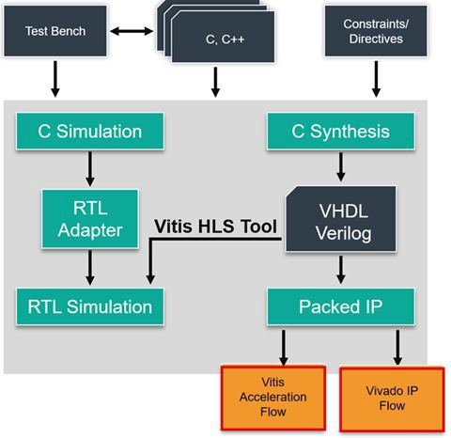
Vitis HLS Development Flow
Architect the algorithm based on the Design Principles
(C-Simulation) Verify the C/C++ Code with the C/C++ testbench
(C-Synthesis) Generate the RTL using HLS
(Co-Simulation) Verify the kernel generated with C++ outputs
(Analyze) Review the HLS synthesis reports and co-simulation reports, analyze
Re-run previous steps until performance goals are met.

Slide 4
Port protocol (Interface Synthesis)
ap_none: No protocol. The interface is a data port.
ap_stable:No protocol. The interface is a data port. Vivado HLS assumes the data port is always stable after reset, which allows internal optimizations to remove unnecessary registers.
ap_ovld: Implements the output data port with an associated reading or writing.
valid
port to indicate when the data is valid for
IMPORTANT!: Vivado HLS implements the input argument or the input half of any read/write arguments with mode ap_none.
ap_vld: Implements the data port with an associated writing.
valid
port to indicate when the data is valid for reading or
ap_ack: Implements the data port with an associated was read or written.
acknowledge
port to acknowledge that the data
ap_hs: Implements the data port with associated
valid
and
acknowledge
ports to provide a two-way
handshake to indicate when the data is valid for reading and writing and to acknowledge that the data
was read or written. “Used in sequential logic functions and protocols

Slide 5
ap_none
void example(char x){
Example function block
#pragma HLS interface ap_none port=x;
X (8:0)
}

Slide 6
ap_vld
void example(char x){
X_o (8:0)
#pragma HLS interface ap_vld port=x;
Example function block
 | X_o_ap_vld
}
X_i (8:0)
X_i_ap_vld

Slide 7
ap_hs
void example(char x){
Example function block
#pragma HLS interface ap_hs port=x;
X_i (8:0)
}
X_ap_ack
X_ap_vld

Slide 8
Port protocol (Cont’d)
ap_bus
ap_fifo
ap_memory
axis
m_axi
s_axilite

Slide 9
Function block protocol (Interface Synthesis)
ap_ctrl_none: no control signals for function (Combinational logic) For Sequential Logic and Pipelined logic:
ap_ctrl_hs:
ap_ctrl_chain:

Slide 10
ap_ctrl_hs
ap_done
Used with Vivado IP to concatenate multiple blocks.
ap_start
Example function block
 | ap_ready
ap_done: When the design has completed operation.
ap_idle: Indicates if the design is idle.
ap_idle
ap_ready: When the block is ready to accept new inputs.
ap_start: when the block can start processing data.

Slide 11
Datatypes
ap_uint<N>: ap_uint allows the use of arbitrary number of bits (N) for an integer variable.
ap_int<N>: This is the signed version of ap_uint. It represents arbitrary precision signed integers.
ap_fixed<N,M>: This is a data type for fixed-point arithmetic. It allows you to specify the total number of bits “N” as well as the number of integer bits “M → el ba2y lldecimal” .
ap_ufixed<N,M>: This is a data type for unsigned fixed-point arithmetic. It allows you to specify the total number of bits “N” as well as the number of integer bits “M → el ba2y lldecimal” .
float: If you need to represent real numbers, you can use the float data type. However, keep in mind that floating-point arithmetic can be more resource-intensive than integer or fixed-point arithmetic.
Structures: You can define your own data types using structures. For example, you could create a structure that contains multiple ap_uint fields.
Arrays: If you need to work with multiple ap_uint values at once, you can use an array

Slide 12
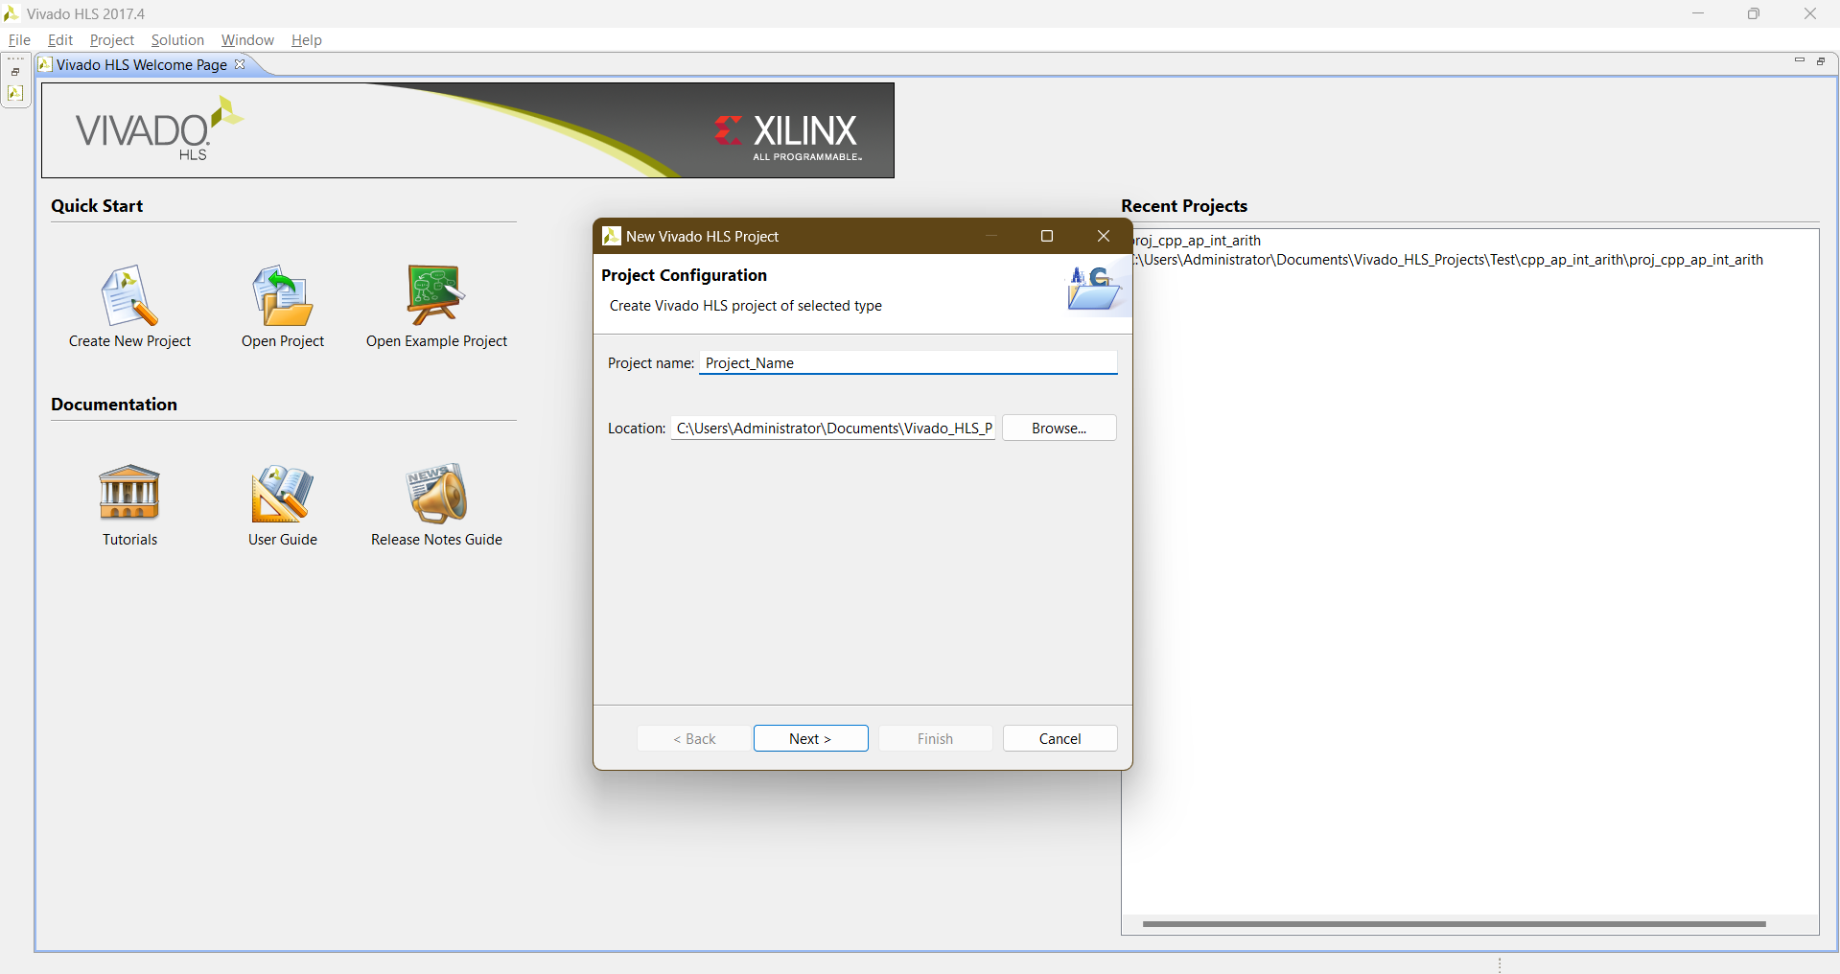
Creating a new project

Slide 13


Slide 14
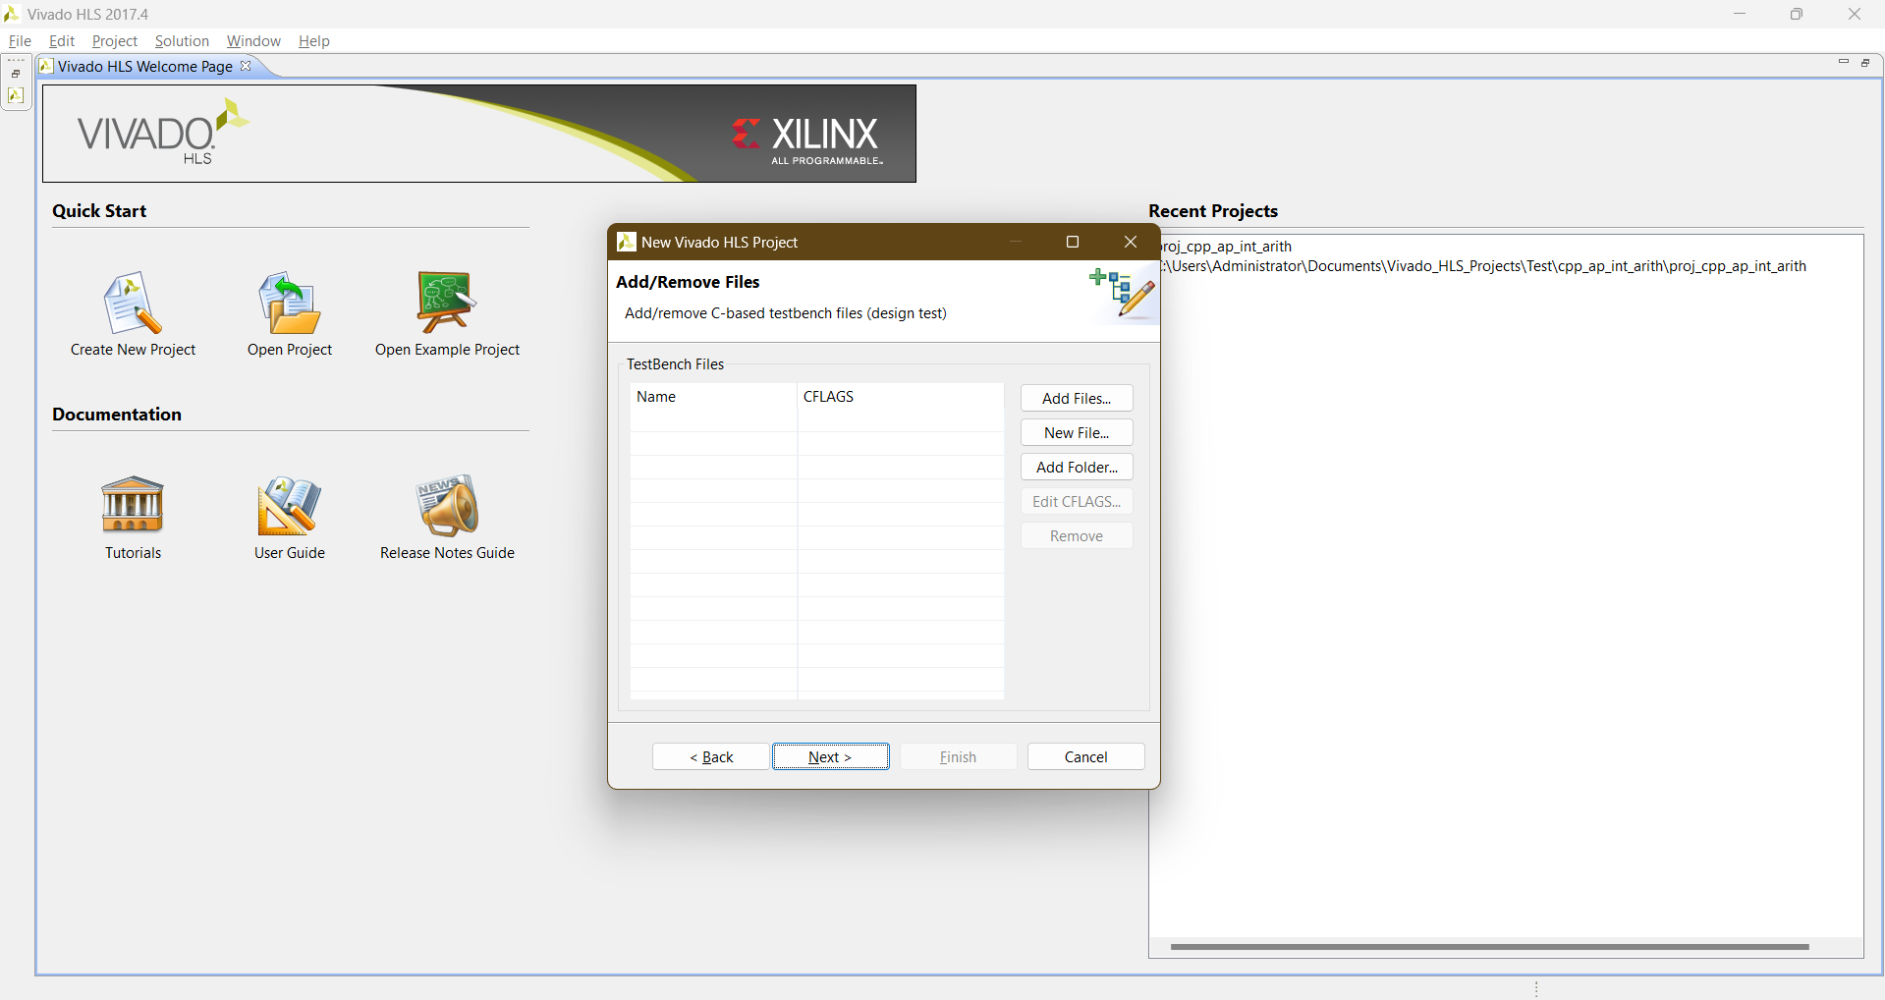

Slide 15
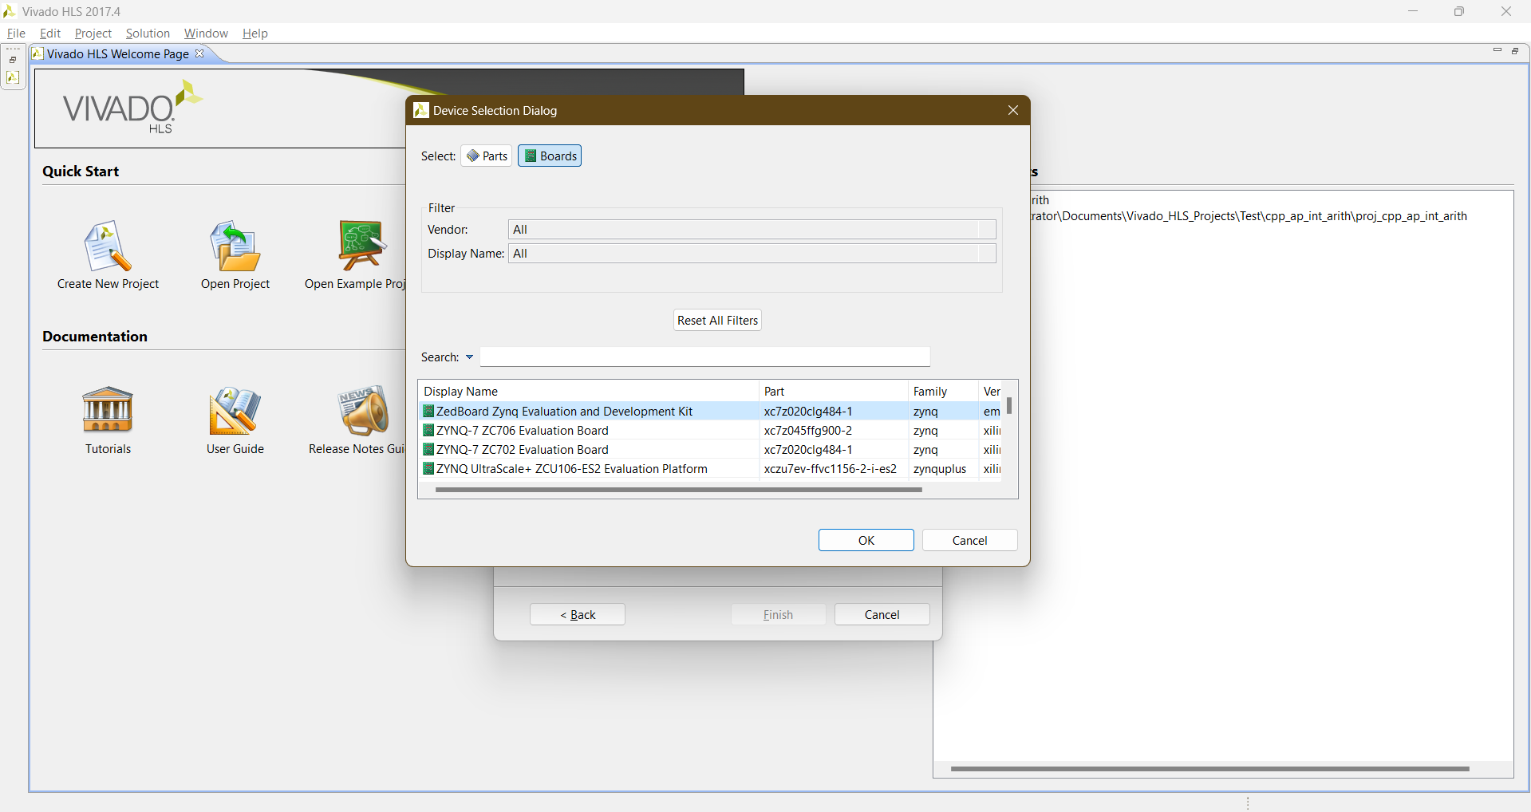

Slide 16
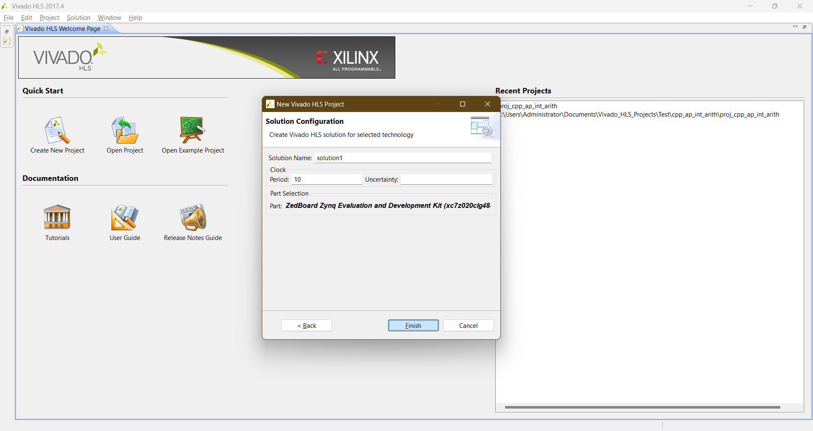

Slide 17
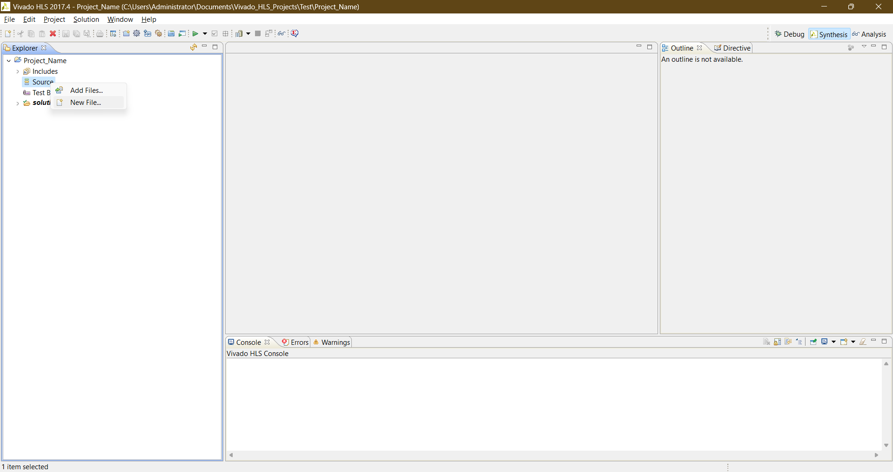

Slide 18
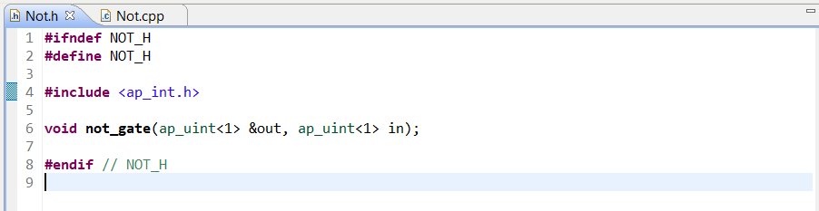
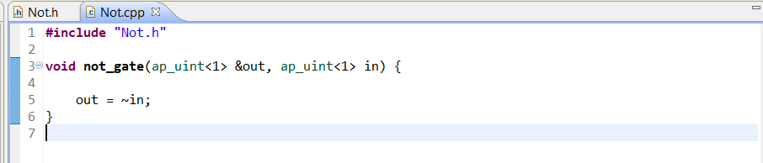
Pass The o/p by reference

Slide 19
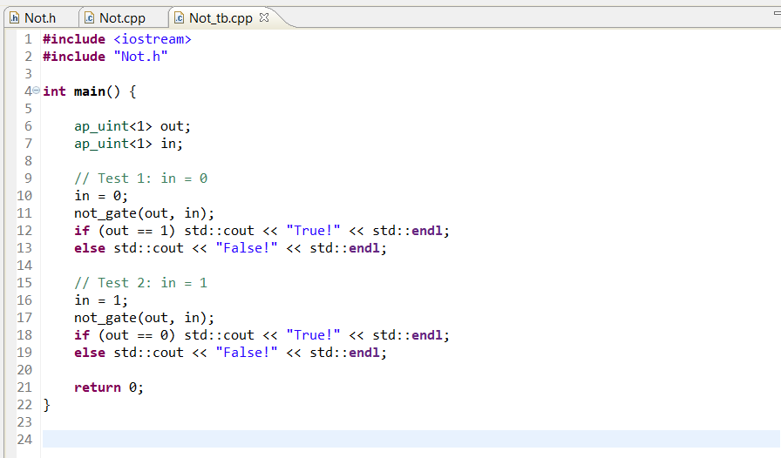
How to write a test bench

Slide 20
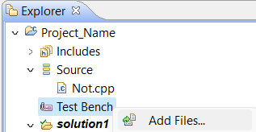
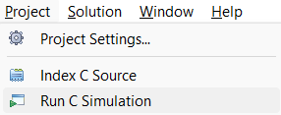
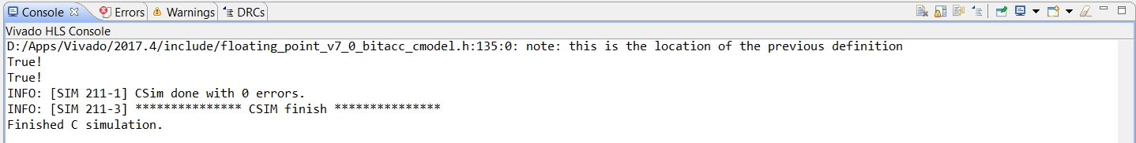
How to run a test bench

Slide 21

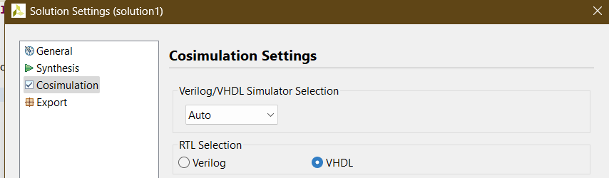
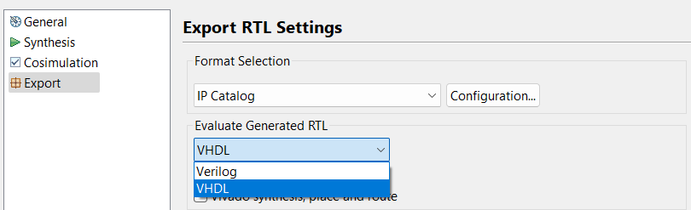

Slide 22

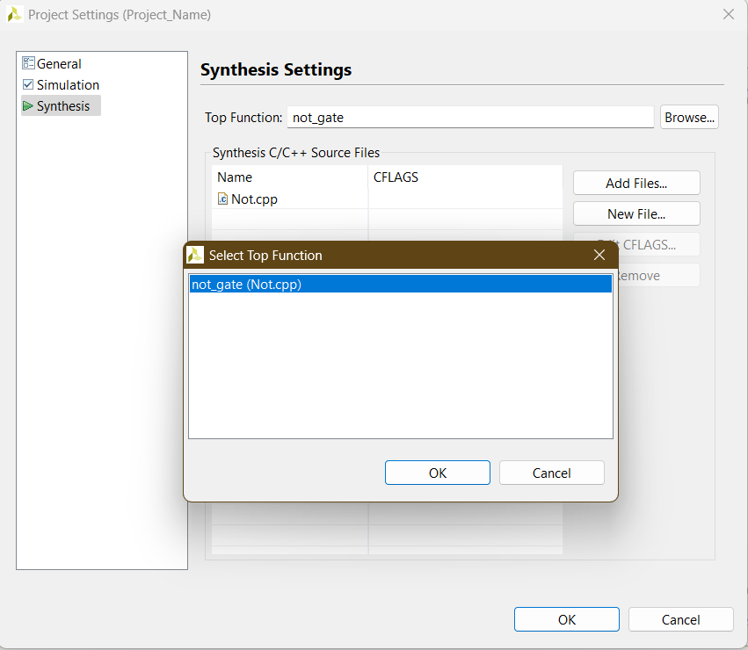


Slide 23
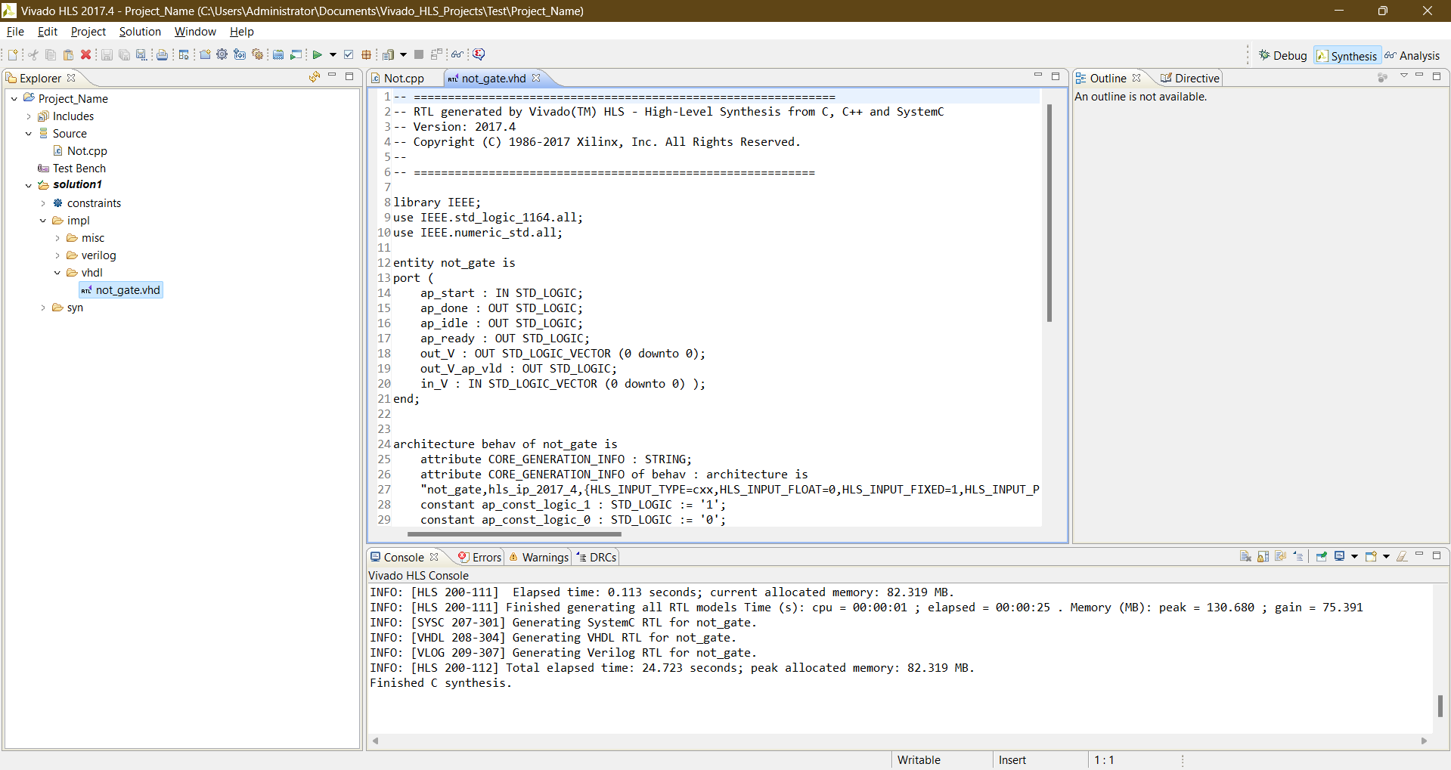

Slide 24
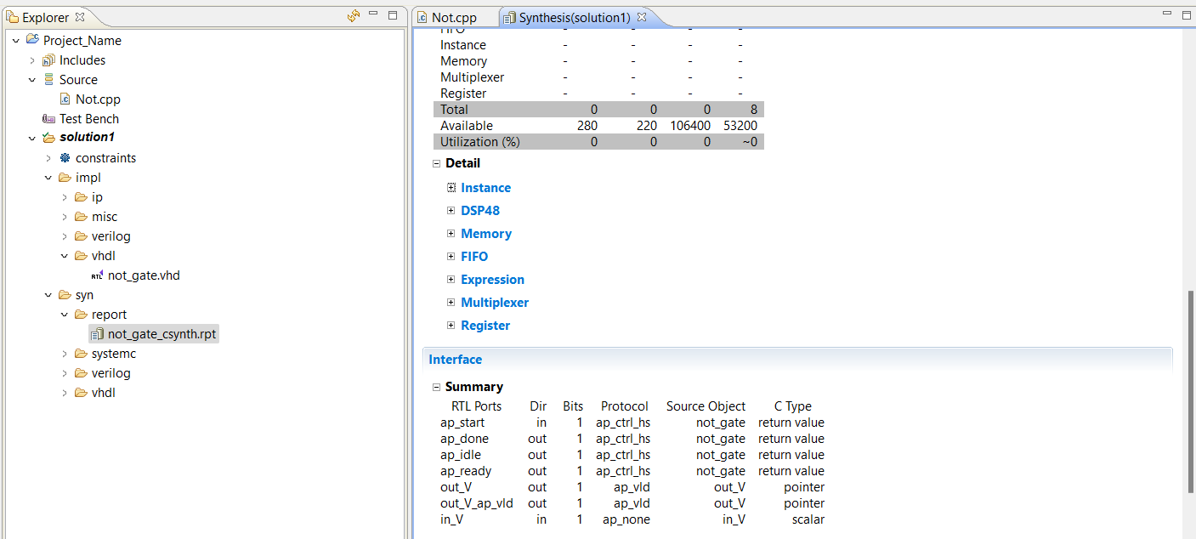
Synthesis Report

Slide 25
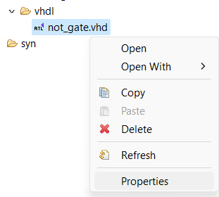
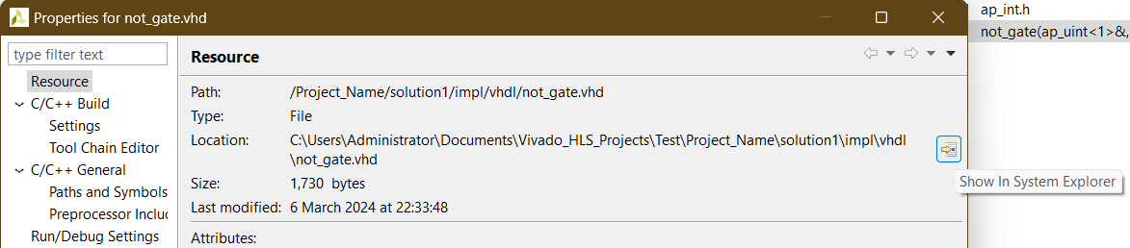
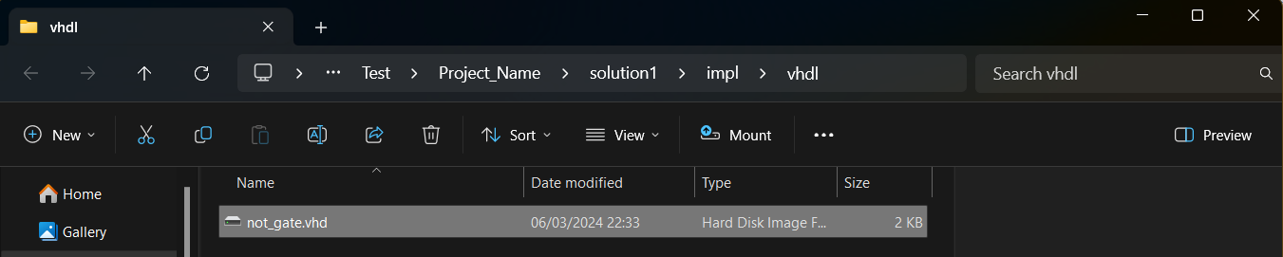
Add the .vhd file to your existing project in Vivado:

Slide 26
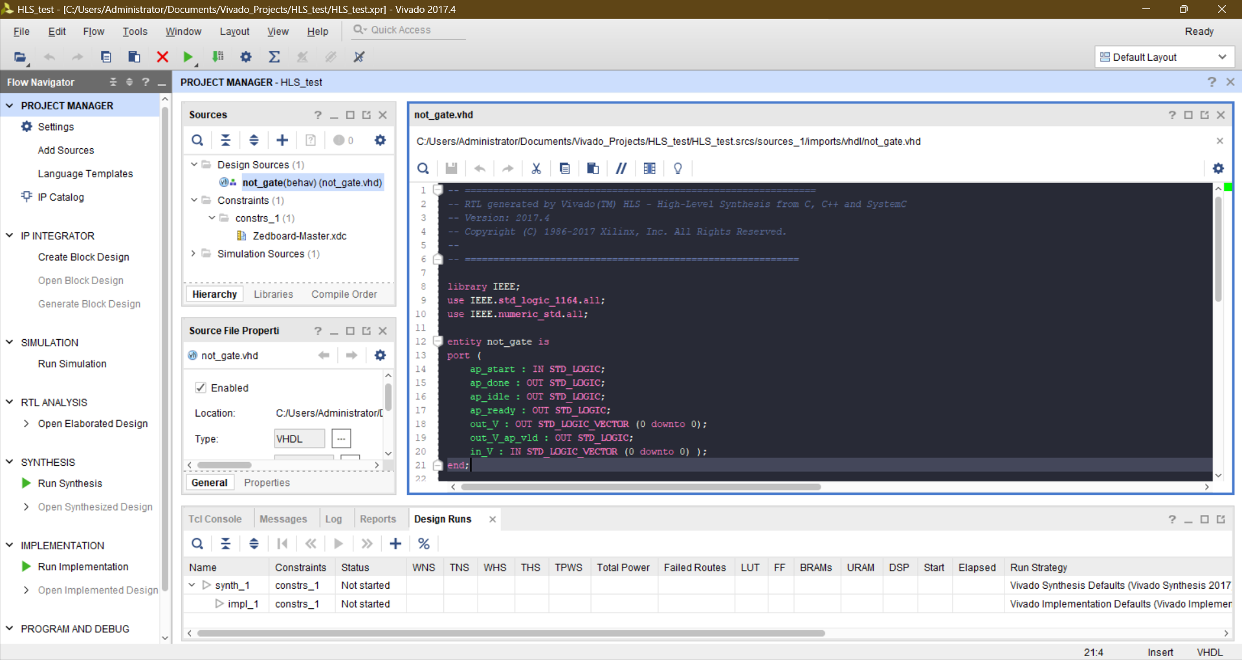

Slide 27
Task
Design a 4-bit adder, multiplier, & divider in C++, then use HLS to synthesize into RTL.

